Slide 1
Hiring Process Analytics
By Sandesha kale

Slide 2
Project Description
Hiring Process Analytics refers to the systematic analysis of data generated throughout the recruitment process to improve decision-making, identify trends, and optimize the entire hiring workflow.
By leveraging data from various stages of hiring organizations can gain actionable insights into how well their recruitment strategies are performing and what can be done to enhance them.
The goal of this project is to use of statistics and Excel to draw meaningful conclusions about the company's hiring process.
The insights could potentially help the company improve its hiring process and make better hiring decisions in the future.

Slide 3
Approach
The first step is to clearly define the goals and key performance indicators (KPIs) of the hiring process. Common objectives include improving hiring efficiency, reducing cost per hire, increasing diversity, and improving the quality of hires.
Accurate and comprehensive data gathering is key to hiring process analytics. Companies can leverage data from various sources throughout the hiring funnel.
After gathering data, it is crucial to clean and prepare it for analysis. This ensures the data is accurate, consistent, and free from duplication or missing values. Clean data leads to more reliable insights.
Once data is prepared, analyze each stage of the hiring process separately. This helps identify bottlenecks and areas of improvement.
Data visualization is essential to make insights actionable. Charts, graphs, and dashboards provide a clear picture of trends and anomalies in the hiring process.
Finally, communicate your findings to relevant stakeholders, including HR leaders, hiring managers, and executives.

Slide 4
Tech-Stack Used
MS EXCEL:-Excel is a versatile tool that can cater to a wide range of tasks from basic data management to advanced analytics, making it an essential resource for tasks like hiring process analysis

Slide 5
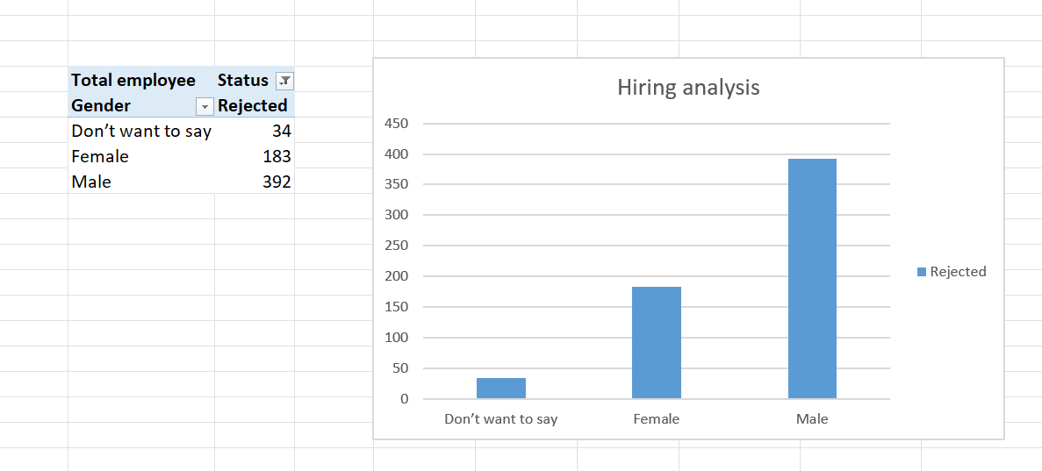
Insights
A. Hiring Analysis

Slide 6
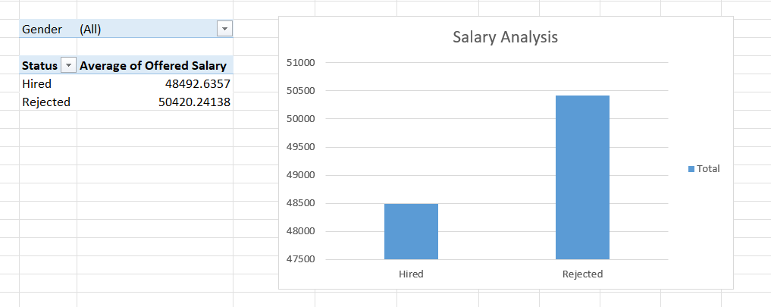
Insights
B. Salary Analysis

Slide 7
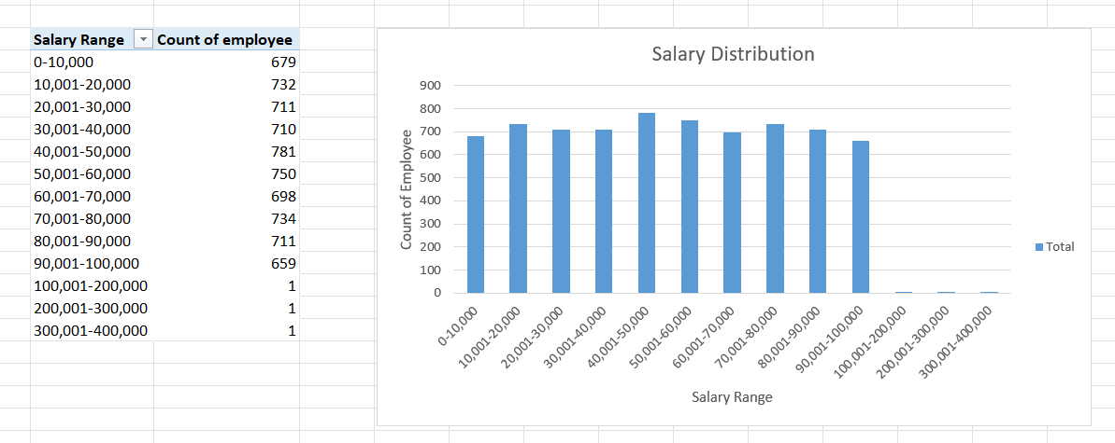
Insights
C. Salary Distribution

Slide 8
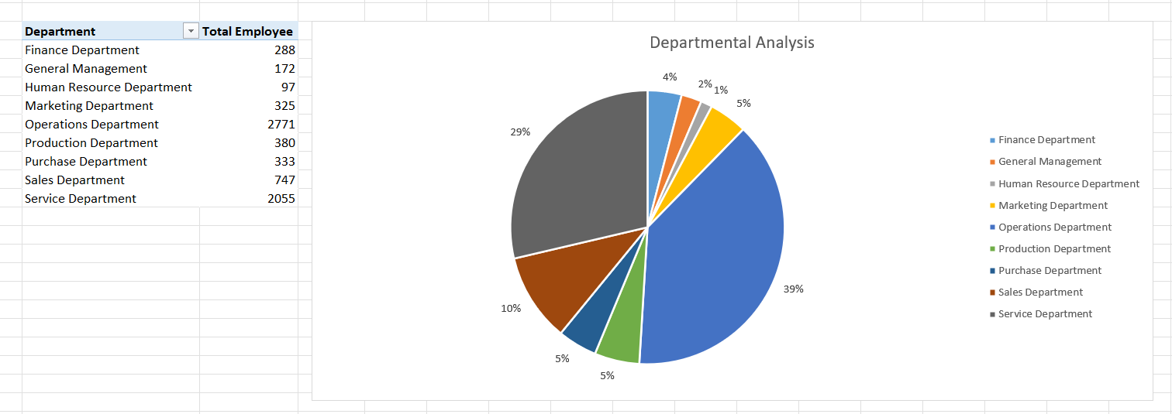
Insights
D. Departmental Analysis

Slide 9
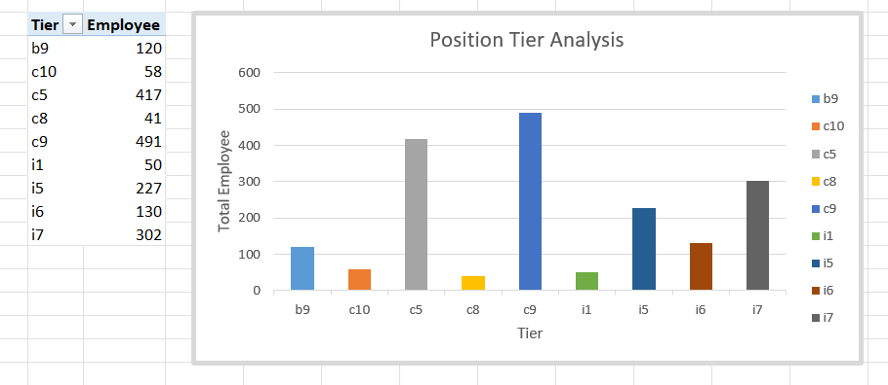
Insights
E. Position Tier Analysis

Slide 10
Result
The hiring process analytics project provided valuable insights into the company's recruitment practices, revealing both strengths and areas for improvement.
A hiring process analytics project can help a company understand its hiring process and make data-driven decisions by providing insights from historical data

